Slide 1

Application: Smart Healthcare Appointment Type: Application Architecture View: Logical View Style: Layered Architecture Pattern
Users
Delivery Channels
Core Business Processes
Data And Information
Technology Enablers
Authentication
Profiles & Auth
Payment Gateways (Stripe)
Patients
Appointments History
Scheduling
Web Dev (React, Express)
Medical Records
Database (PostgreSQL)
Records
Doctors
Web Browser
Payments & Invoices
Security (JWT, RBAC)
Payments
Logs & Audits
Cloud Services (AWS )
Healthcare Providers
Messaging
Analytics & Reports
Github & Delivery Pipeline
Insurance Claims
Security
Logging & Compliance Audits (CloudWatch API)
Admin Staff
Prescription Refills

Slide 2
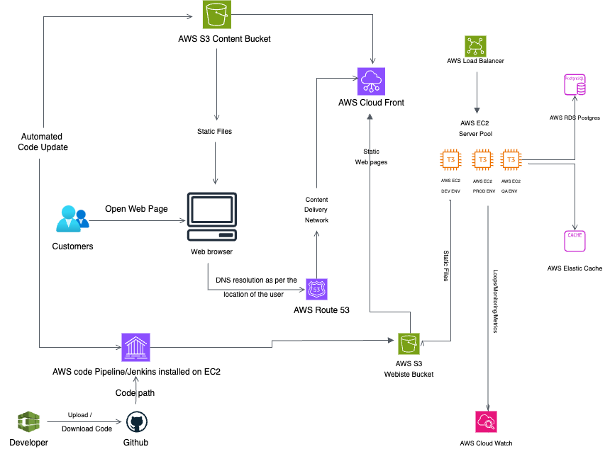
Application: Smart Healthcare Appointment Type: Application Architecture
View: Process View Style: Client-Server Pattern

